Slide 1
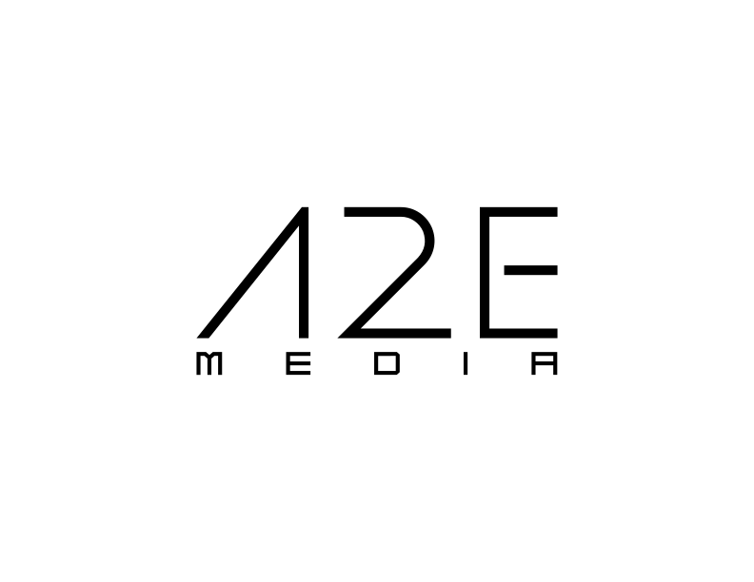
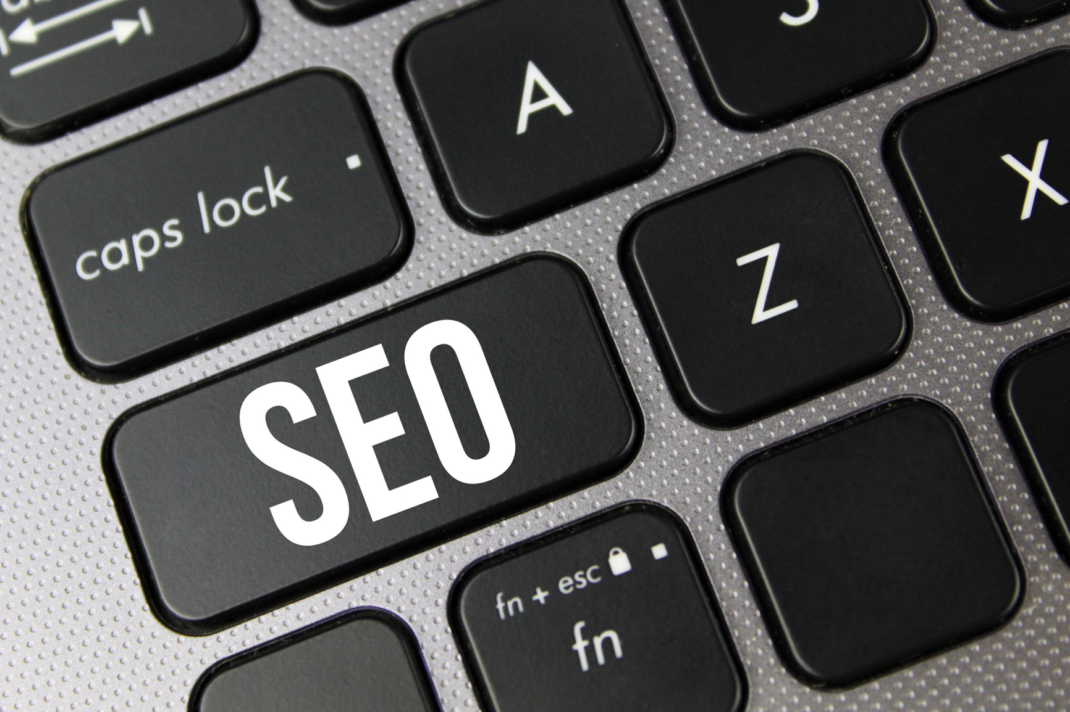
SEO SERVICES
Our SEO services boost your brand to the top of search results, using custom keywords, optimized content, and technical SEO to drive growth and lasting visibility.
Elevate Your Digital Reach

Slide 2



Strategic SEO for Lasting Brand Visibility
Our SEO solutions go beyond traditional optimization to strategically position your brand at the top of search results. With cutting-edge tools and data-driven insights, we craft custom keyword strategies, optimize content and site architecture, and deliver advanced technical SEO that propels your website to new heights. We focus on attracting engaged audiences who are primed to connect with your brand, ensuring each element of SEO fuels measurable growth. From local prominence to global reach, we empower your digital presence with sustainable, long-term visibility.
WWW.ATWOEMEDIA.COM
Text Here
Text Here
It is a long established fact that a content here', making it look like readable English.
It is a long established fact that a content here', making it look like readable English.

Slide 3

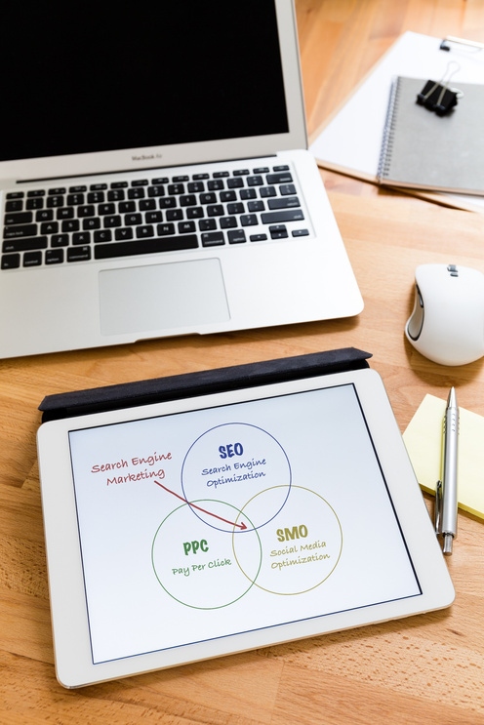

Our SEO packages
Pack AL Noojom
Pack Al Thuraya
Pack Al Qasr
For small businesses aiming to enhance online visibility on a budget.
For growing businesses ready to invest in advanced optimization to boost search rankings
For large companies or those striving to dominate their market with an advanced SEO strategy
WWW.ATWOEMEDIA.COM

Slide 4
Basic SEO (Pack Al Nojoom)
01
02
“SEO increases both the quantity and quality of traffic to your website through organic search results”
Pack Al Nojoom provides essential SEO strategies for businesses looking to establish a foundation in search visibility. With targeted keyword research, on-page optimization, and essential backlink building, this package covers all the basics for increasing organic reach.
Includes:
Research of 10-15 Keywords, 1 SEO-Optimized Article, 20 Quality Backlink Submissions, Keyword Optimization for 3 Pages, Page Load Optimization (1 Page), Title Tag Optimization (3 Pages), Body Text Optimization (3 Pages), Google Analytics Setup, HTML Code Cleanup (1 Page), Internal Link Structuring, and Monthly Performance Report

Slide 5
Growth SEO (Pack Al Thuraya)
01
02
“Effective SEO aligns your site with search engine algorithms, enhancing your site’s ranking and reach”
Pack Al Thuraya offers more in-depth SEO strategies, ideal for businesses expanding their digital footprint. This package includes comprehensive keyword analysis, additional SEO-optimized articles, and an increase in backlink submissions, making it suitable for brands aiming to climb search rankings
Includes:
Research of 25-30 Keywords, 2 SEO-Optimized Articles, 50 High-Authority Backlinks, Keyword Optimization for 5 Pages, Page Load Optimization (3 Pages), Title Tag Optimization (5 Pages), Body Text Optimization (5 Pages), Google Analytics & Search Console Setup, HTML Code Cleanup (3 Pages), Internal Link Structuring, Custom Service Adjustments, and Monthly Report with Strategic Recommendations

Slide 6
Premium SEO (Pack Al Qasr)
01
02
“Effective SEO aligns your site with search engine algorithms, enhancing your site’s ranking and reach”
Pack Al Thuraya offers more in-depth SEO strategies, ideal for businesses expanding their digital footprint. This package includes comprehensive keyword analysis, additional SEO-optimized articles, and an increase in backlink submissions, making it suitable for brands aiming to climb search rankings
Includes:
Research of 25-30 Keywords, 2 SEO-Optimized Articles, 50 High-Authority Backlinks, Keyword Optimization for 5 Pages, Page Load Optimization (3 Pages), Title Tag Optimization (5 Pages), Body Text Optimization (5 Pages), Google Analytics & Search Console Setup, HTML Code Cleanup (3 Pages), Internal Link Structuring, Custom Service Adjustments, and Monthly Report with Strategic Recommendations

Slide 7
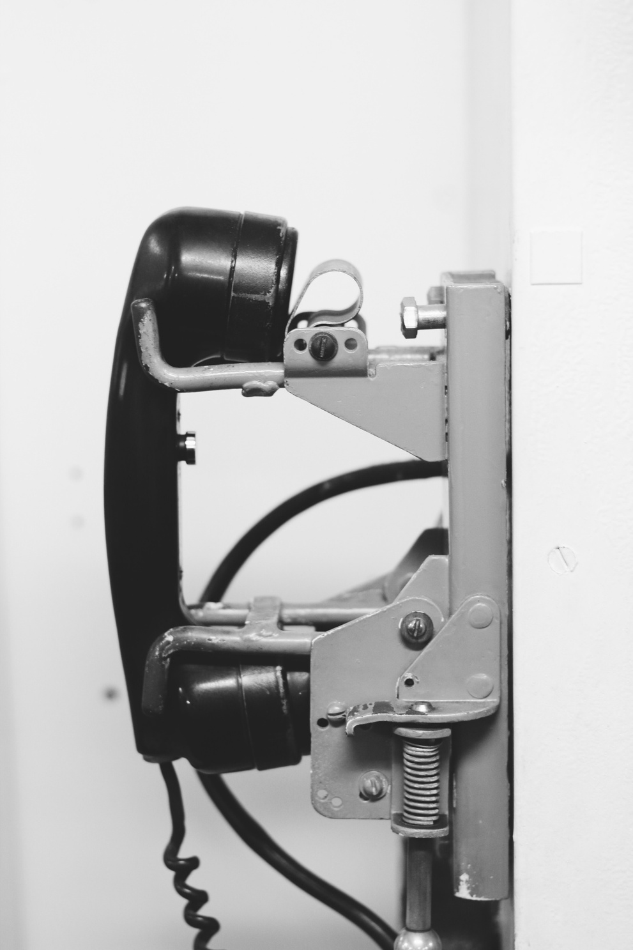


Contact Us
Phone
Web Address
Email Address
+971 55 138 1498
www.atwoemedia.com
contact@atwoemedia.com

Slide 8
end.

